Slide 1

Welcome
www.eudicom.eu

Slide 2
E Comics distribution
Eudicom
MID Presentation
Preliminary European Study Results
29 January 2021

Slide 3
Agenda
11h00 -11h05 Introduction of session – Thierry Baujard - Izneo
11h05 – 11h20 Creative Europe – Opportunities for the Book Sector- Arnaud Pasquali – European Commission
11h20 – 11h30 Project vision, objectives and activities – Thierry Baujard – Izneo
11h30 – 11h45 Why a project on distribution of E-comics – General trends – Luc Bourcier – Izneo
11h45 – 11h55 Preliminary results from quantitative and qualitative questionnaires- Opportunities and challenges – Enrico Turrin – FEP
11h55 – 12h00 – Italian market – Details – Piero Attanasio - AIE - Italy
12h00- 12h05 – Polish Market – Details - Paweł Timofiejuk – PSK - Poland
12h05 – 12h10 – Spanish Market – Details - Miguel Jiménez - FGEE - Spain
12h10 – 12h15 – Other countries – Details - Enrico Turrin – FEP - Belgium
12h15 – 12h30 – Questions and Comments from Clement Carasco – Creative Europe EU - Moderated by Thierry Baujard Izneo

Slide 4
Agenda
11h00 -11h05 Introduction of session – Thierry Baujard - Izneo
11h05 – 11h20 Creative Europe – Opportunities for the book sector - Arnaud Pasquali – European commission
11h20 – 11h30 EUDICOM - Project vision, objectives and activities – Thierry Baujard – Izneo
11h30 – 11h45 Why a project on distribution of E-comics – General trends – Luc Bourcier – Izneo
11h45 – 11h55 Preliminary results from quantitative and qualitative questionnaires- Opportunities and challenges – Enrico Turrin – FEP
11h55 – 12h00 – Italian market – Details – Piero Attanasio - AIE - Italy
12h00- 12h05 – Polish Market – Details - Pawel Timofieujuk – PSK - Poland
12h05 – 12h10 – Spanish Market – Details - Miguel Jiménez - FGEE - Spain
12h10 – 12h15 – Other countries – Details - Enrico Turrin – FEP - Belgium
12h15 – 12h30 – Questions and Comments from Clement Carasco – Creative Europe EU - Moderated by Thierry Baujard Izneo

Slide 5
EU Creative Europe Programme
(2021-27)
Opportunities for the book sector
Arnaud Pasquali
European Commission, DG EAC
Arnaud.pasquali@ec.europa.eu

Slide 6

CREATIVE EUROPE
A budget of €2,4 billion to:
Promote cultural and linguistic diversity and heritage
Increase the competitiveness of the cultural and creative sectors
Strands
CULTURE: European cultural and creative sectors 804M€
MEDIA: European audiovisual industry 1.427B€
CROSS SECTORAL: Actions spanning all cultural and creative sectors; and to support a free, diverse and pluralistic media environment 211M€
Notes:
Example layout of a slide with a graph

Slide 7
Creative Europe – Culture
Calls to be launched in the first semester 2021
support to cultural cooperation projects,
networks of professional organisations,
platforms for the promotion of European artists and works,
Support for translation and promotion of literature (all genres incl comics) either as individual publishers or as groupings of publishers, booksellers …

Slide 8
Creative Europe Programme 2014-20
examples of cooperation and platforms projects in the book sector
Versopolis poetry – promoting poetry in Europe
Transbook – the future of children books
Aldus – network of book fairs
Turn on literature – Literature and education
On comics
Europe comics – promotion of European comics and graphic novels
Comics - A new language for Europe – experimenting collaborative creative methods
Invisible Lines – training illustrators
And of course : EUDICOM….

Slide 9
Culture – cooperation
Objectives and priorities
objectives :
creation : to strengthen the transnational creation and circulation of European works
innovation : to enhance the capacity of European cultural and creative sectors to nurture talents, to innovate, to prosper and to generate jobs and growth
Priorities :
Audience, Social inclusion, Environment & green deal, New technology, International, Book sector-specific priorities

Slide 10
PLATFORMS
for the promotion of emerging artists
“BtoC”
  Europe-wide programming of cultural & artistic activities
  mobility & visibility of emerging European creators & artists
  Branding strategy

Slide 11
EUROPEAN NETWORKS
of professional organisations
“BtoB”
  Reinforcing skills including the use digital technologies, innovative approaches to audience development new business and management models)
  Strengthen international networking in order to facilitate access to professional opportunities

Slide 12
Support to the circulation of
European literature
  Support to
  the translation of European books
  the promotion of translated works
  Cooperation and collaboration between publishers, bookshops, festivals etc..

Slide 13
Support to individual artists
mobility for individuals working in the cultural and creative sectors
establishing or improving collaborations, creating new work, developing audiences and so on

Slide 14
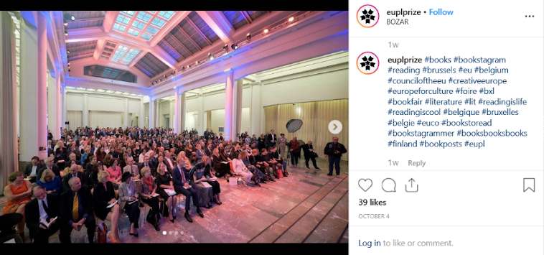

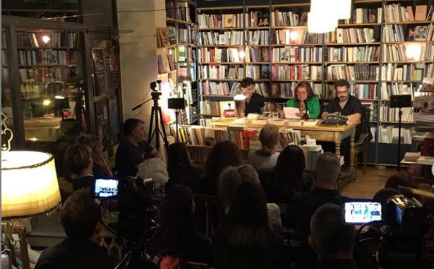
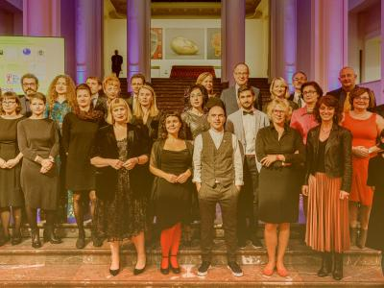
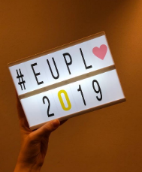

The aim of the European Union Prize for Literature (EUPL) is to put the spotlight on the creativity and diverse wealth of Europe’s contemporary literature in the field of fiction, to promote the circulation of literature within Europe and to encourage greater interest in non-national literary works.

Slide 15
Cross-sector actions
  Support to
  Innovative approaches to content creation, access, distribution and promotion
  Support to the newsmedia sector
  Creative Europe desks

Slide 16
Agenda
11h00 -11h05 Introduction of session – Thierry Baujard - Izneo
11h05 – 11h20 Creative Europe – Opportunities for the Book Sector- Arnaud Pasquali – European Commission
11h20 – 11h30 Project vision, objectives and activities – Thierry Baujard – Izneo
11h30 – 11h45 Why a project on distribution of E-comics – General trends – Luc Bourcier – Izneo
11h45 – 11h55 Preliminary results from quantitative and qualitative questionnaires- Opportunities and challenges – Enrico Turrin – FEP
11h55 – 12h00 – Italian market – Details – Piero Attanasio - AIE - Italy
12h00- 12h05 – Polish Market – Details - Pawel Timofieujuk – Poland
12h05 – 12h10 – Spanish Market – Details - Miguel Jiménez - FGEE - Spain
12h10 – 12h15 – Other countries – Details - Enrico Turrin – FEP - Belgium
12h15 – 12h30 – Questions and Comments from Clement Carasco – Creative Europe EU - Moderated by Thierry Baujard Izneo

Slide 17
Eudicom Project - Welcome
Strengthen Distribution of European Digital Comics
Consortium:
Izneo (France)
Italian Book Publishers association
Spanish Book Publishers association
Polish Comics Association
Federation of European Publishers
24 months - - September 2020 till August 2022
18 September 2020

Slide 18
Eudicom Project – main goals
Capacity Building programme for European comics publishers:
Technology, market opportunities, business model, marketing in a digital environment
Help and support publishers in digital experimentation
Share best practices and knowledge across Europe.
Mid Term:
Reinforce European comics talents on digital platform
Improve accessibility and distribution of European e-comics
Support growth of European comics sector
Bring new distribution opportunities for the sector

Slide 19
Expected impact
Short term:
  Increase and share knowledge about E comics (National publishers associations)
  Digitalization strategy ready to be implemented by comics publishers
  Raising awareness on digital distribution strategies for comics authors too
Mid Term
  Increased cooperation between national associations and comics publishers
  Increase cooperation and partnerships between publishers
  Seizing digital opportunities for comics players
Long Term
  Position European comics as a global leader

Slide 20
Eudicom Project Steps
1 Local research and identification of comics publishers to understand market status and their own requirements
2 Online resources through webinars and MOOC to cover main issues faced by comics publishers in going digital
3 Exchanges of best practices and knowledge online and through high-level events
4 Testphase on e-comics platform for local publishers
5 Communication programme for dissemination and publishers recruitment all over Europe

Slide 21
Eudicom Project planned Events
Event 1 – EU Market Research results – MIB – Online 29 January 2021
Event 2 - Frankfurt Book Fair – Oct 21
Event 3 - Readmagine - Madrid – June 22

Slide 22
Agenda
11h00 -11h05 Introduction of session – Thierry Baujard - Izneo
11h05 – 11h20 Creative Europe – Opportunities for the Book Sector- Arnaud Pasquali – European Commission
11h20 – 11h30 Project vision, objectives and activities – Thierry Baujard – Izneo
11h30 – 11h45 Why a project on distribution of E-comics – General trends – Luc Bourcier – Izneo
11h45 – 11h55 Preliminary results from quantitative and qualitative questionnaires- Opportunities and challenges – Enrico Turrin – FEP
11h55 – 12h00 – Italian market – Details – Piero Attanasio - AIE - Italy
12h00- 12h05 – Polish Market – Details - Paweł Timofiejuk – PSK -Poland
12h05 – 12h10 – Spanish Market – Details - Miguel Jiménez - FGEE - Spain
12h10 – 12h15 – Other countries – Details - Enrico Turrin – FEP - Belgium
12h15 – 12h30 – Questions and Comments from Clement Carasco – Creative Europe EU - Moderated by Thierry Baujard Izneo

Slide 23

User centric
comic-books
mangas
graphic novels
webtoons
n°1 pure-player in Europe
Rich digital comic-book experience
Mobile first
International
in
French
English
German
Dutch
innovating
… and distribution to
to other platforms

Slide 24
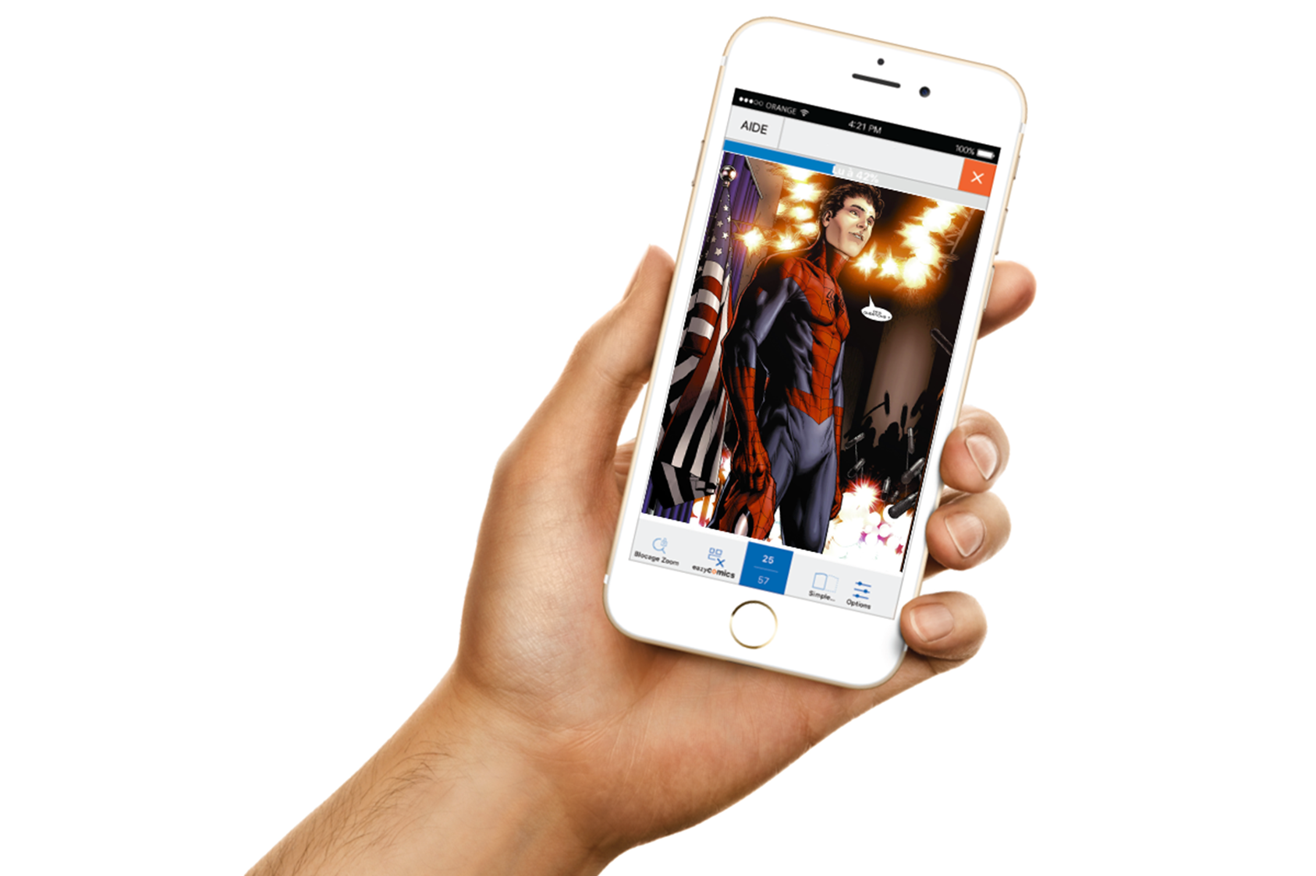
  Why a project on distribution of e-comics ?
  Digital comics: a growing market but Europe is lagging behind

Slide 25
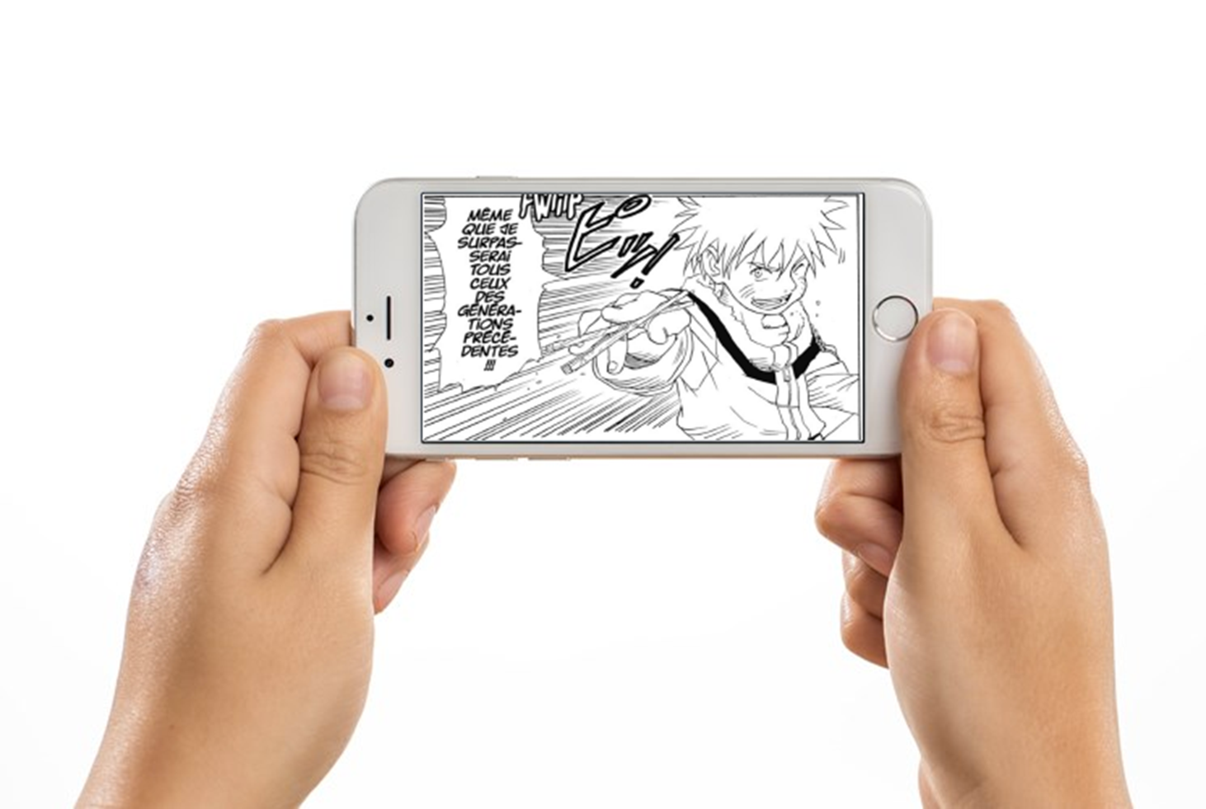
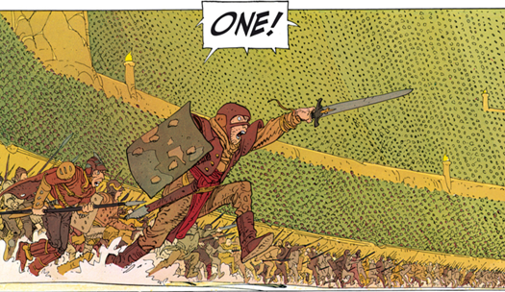
  1. The generation factor

Slide 26

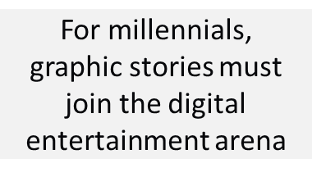

Slide 27
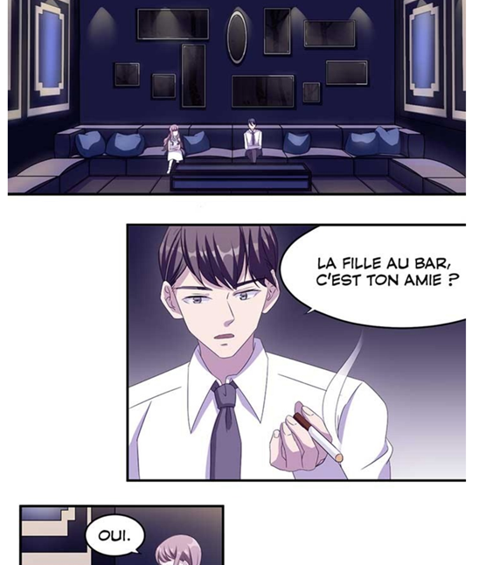



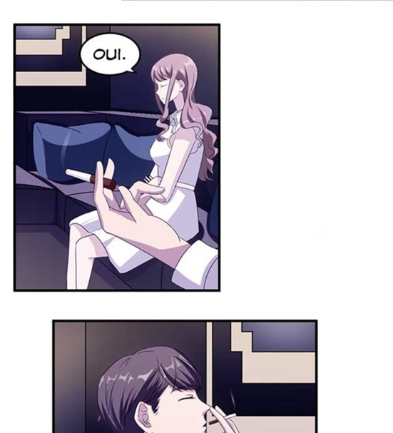

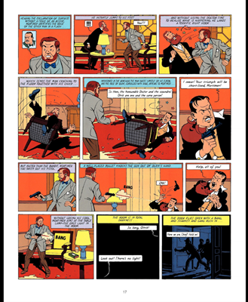
Convert digital entertainment users …
…rather than comic-book readers

Slide 28

  2. The geographical factor

Slide 29
Digital plays a growing part in leading marketplaces
A worldwide market value of 6 billion €, with four major territories :
JAPAN : 2 600 M€
Average spend/ capita : 17€/ year
Share of digital : 55%
43%
SOUTH KOREA : 662 M€
11%
Average spend/ capita : 8,6€/ year
Share of digital : 50% (2015)
USA : 927 M €
15%
Average spend/ capita : 2,7€/ year
Share of digital : 8,7%
FRANCE : 550M € (2020)
8%
Average spend/ capita : 6,9€/year
Share of digital : 3%
22%
REST OF THE WORLD : 1 342 M €
2016 figures- Sources : GFK (F), KT Research (K), Research Institute for Publications (J), iCV2 (USA) -- *: 2018 figures

Slide 30

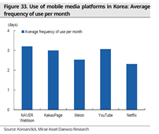
Webtoon: the Korean disruptive format
Time spent on webtoons tends to be longer than time spent reading paper comics.
Webtoon series appeal to non-readers including in countries without comics marketplace
Webtoons have the potential to generate higher average revenue per paying user (ARPPU) than Netflix, YouTube or Spotify. In terms of user engagement indicators (time spent, frequency, retention, etc.), webtoons in Korea have already surpassed music streaming services and are now comparable to video streaming services.
Naver is the largest webtoon platform by revenue and users across Korea, Japan, the US, and major countries in Southeast Asia. The service is in the early stages of monetizing its 63mn MAU,
(excerpts from Mirae Asset Daewoo Research report about Naver – sept 2019)

Slide 31

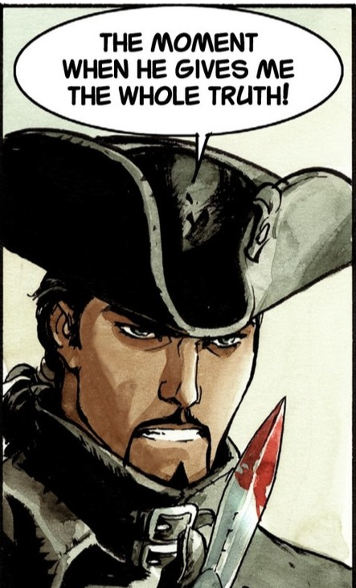
  3. The EUDICOM Project

Slide 32



A focus on distribution because platforms are the gateway to users
better understand Eur. comic-book market (print & digital) – a prerequisite
help Euro comic-book publishers to go digital 🡪 content accessible through digital platforms
identify levers to grow digital reading of comic-books across Europe 🡪 reading through platforms
support the development of digital comic-book initiatives 🡪 in formats accepted by platforms
circulate local Euro contents within Europe and beyond 🡪 multilingual platforms
encourage the emergence of competitive Euro platforms to fight against GAFAMs and Asian platforms

Slide 33
EUDICOM
→ help Euro comic-book publishers go digital
and
→ make Europe a much stronger place for digital comics

Slide 34
Agenda
11h00 -11h05 Introduction of session – Thierry Baujard - Izneo
11h05 – 11h20 Creative Europe – Opportunities for the Book Sector- Arnaud Pasquali – European Commission
11h20 – 11h30 Project vision, objectives and activities – Thierry Baujard – Izneo
11h30 – 11h45 Why a project on distribution of E-comics – General trends – Luc Bourcier – Izneo
11h45 – 11h55 Preliminary results from quantitative and qualitative questionnaires- Opportunities and challenges – Enrico Turrin – FEP
11h55 – 12h00 – Italian market – Details – Piero Attanasio - AIE - Italy
12h00- 12h05 – Polish Market – Details - Paweł Timofiejuk – PSK - Poland
12h05 – 12h10 – Spanish Market – Details - Miguel Jiménez - FGEE - Spain
12h10 – 12h15 – Other countries – Details - Enrico Turrin – FEP - Belgium
12h15 – 12h30 – Questions and Comments from Clement Carasco – Creative Europe EU - Moderated by Thierry Baujard Izneo

Slide 35
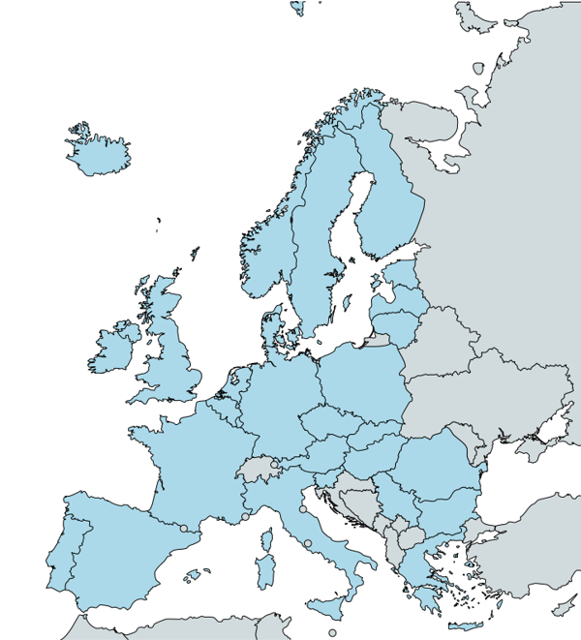
About FEP
FEP is an independent, non-commercial umbrella association of national book publishers' associations
FEP represents 29 national associations of publishers of books, learned journals and educational materials from 28 countries all over Europe, especially from the EU and of the EEA
Founded in 1967, FEP deals with European legislation and advises publishers associations on legislative and policy issues

Slide 36
The research
Objectives
  Collecting information on the comic book market in Europe
  Assessing the degree of digitisation of the European comic book market
  Gathering input for the development of training tools
Methodology
  Quantitative questionnaire (partners in focus countries FR, IT, PL, ES + all FEP members)
  Qualitative questionnaire (interviews with publishers and stakeholders)

Slide 37
Preliminary results - general
Overview of responses
  Detailed information from focus countries: France, Italy, Poland, Spain
  Comprehensive information from other major markets: Belgium, Germany
  A little information from about 20 more countries
Initial findings
  The comic book market is only significant in a limited number of territories
  Detailed information on comic book sales, especially in digital, is hard to come by
  Comics publishing is somewhat of a niche sector, often with relatively tenuous links with the rest of the sector (also in association terms)
  In most cases, the digital penetration in the sector is very low

Slide 38
Preliminary results - quantitative
Data on main markets surveyed
  Production: big markets (FR, DE, IT, ES) produce 3-4,000 new titles per year (France on top), mid-sized ones (BE, PL) 1-2,000 (Belgium punches above its weight)
    European comics and manga the main genres
  Publishers: 100 to 400 in DE, IT, FR (FR has the most), <50 in ES, PL, 75 in BE (high given overall size)
  Turnover: comics represent 2 to 6% of the publishers’ sales in most territories, with notable exceptions France (15%) and French-speaking Belgium (around 33% of publishing revenues)
  Average prices: between 7.50 and 15 EUR, with no clear link with a country’s income
  Digital catalogues: a few to several thousand titles in IT, ES, DE and more than 20,000 in FR; very few in PL

Slide 39
Preliminary results - quantitative
Data on other markets
  Production: very little information available; likely in the hundreds of titles per year
  Publishers: often very few, sometimes barely any
  Turnover: very small share of total market, in most cases <2% (there are exceptions)
  Market overview: niche market, mostly based on imported titles
  Level of digitisation: very low

Slide 40
Preliminary results - qualitative
Digital presence and strategy
  Digital presence and marketing but little if any digital products and sales
Plans to go digital
  There is an intention, provided the conditions are ripe
Attitude towards digital
  Positive but cautious; purely digital option not seen as viable
Challenges and opportunities of going digital
  Readers’ attachment to paper (collectors), piracy, business models, risk of wrong placement of product (digital media), webtoons; still a potential opportunity
Possible use for a dedicated platform
  Yes! Accessible, fair, effective, technologically supportive; huge investment

Slide 41
Preliminary remarks
Data collection
  There are difficulties in finding data and in comparing different countries
  We plan to continue or effort throughout the project
  We welcome input from all interested stakeholders
The market
  The digital market for comics is very small
  There is a huge opportunity for growth if the demand is there, a largely untapped potential
  There is potential for our platform to provide support in tapping this potential
  There is a risk that non-European players fill that void

Slide 42
Agenda
11h00 -11h05 Introduction of session – Thierry Baujard - Izneo
11h05 – 11h20 Creative Europe – Opportunities for the Book Sector- Arnaud Pasquali – European Commission
11h20 – 11h30 Project vision, objectives and activities – Thierry Baujard – Izneo
11h30 – 11h45 Why a project on distribution of E-comics – General trends – Luc Bourcier – Izneo
11h45 – 11h55 Preliminary results from quantitative and qualitative questionnaires- Opportunities and challenges – Enrico Turrin – FEP
11h55 – 12h00 – Italian market – Details – Piero Attanasio - AIE - Italy
12h00- 12h05 – Polish Market – Details - Paweł Timofiejuk – PSK - Poland
12h05 – 12h10 – Spanish Market – Details - Miguel Jiménez - FGEE - Spain
12h10 – 12h15 – Other countries – Details - Enrico Turrin – FEP - Belgium
12h15 – 12h30 – Questions and Comments from Clement Carasco – Creative Europe EU - Moderated by Thierry Baujard Izneo

Slide 43

AIE is the Italian Publishers Association representing 90% c.ca of the Italian book market
Comics publishers are also members
In connection with Eudicom, in 2020 we set up a “Comics publishers working group”

Slide 44
Italian comic books in numbers: the production
265 active publishers
2,904 new releases in 2019
  Average price: 14.07 €
28,023 books in commerce
European comics
Mangas
US comics
Graphic Novel
Source: IE - Informazioni Editoriali

Slide 45
Italian comic books in numbers: digital production
603 digital new releases
  21% of printed titles
  + 63% compared to 2019
Average price: 9.3 €
  67% of the printed version
3,776 digital books in commerce
  13% of printed titles)
  + 38% compared to 2019
European comics
Mangas
US comics
Graphic Novel
Source: IE - Informazioni Editoriali

Slide 46
Italian comic books in numbers: sales
Total sales 2020 in book trade channels: 43 million €
+42% vs. 2019
This does not include sales in «fumetterie», newsstands and during fairs and events
Boom in last 2-3 years of comics books series sold in bundle with newspapers
Source: AIE elaboration on different sources

Slide 47
A rich calendar of comics fairs
71 comics fairs planned in 2021
  + 2 in the Italian speaking Switzerland
  1.4 per week
  in 50% of days there is a comics fair somewhere in Italy
Spread in all areas of the country and very live in small cities
North-West
North-East
Center
South & Islands
Source: www.comicsviews.it

Slide 48
Agenda
11h00 -11h05 Introduction of session – Thierry Baujard - Izneo
11h05 – 11h20 Creative Europe – Opportunities for the Book Sector- Arnaud Pasquali – European Commission
11h20 – 11h30 Project vision, objectives and activities – Thierry Baujard – Izneo
11h30 – 11h45 Why a project on distribution of E-comics – General trends – Luc Bourcier – Izneo
11h45 – 11h55 Preliminary results from quantitative and qualitative questionnaires- Opportunities and challenges – Enrico Turrin – FEP
11h55 – 12h00 – Italian market – Details – Piero Attanasio - AIE - Italy
12h00- 12h05 – Polish Market – Details - Paweł Timofiejuk – PSK - Poland
12h05 – 12h10 – Spanish Market – Details - Miguel Jiménez - FGEE - Spain
12h10 – 12h15 – Other countries – Details - Enrico Turrin – FEP - Belgium
12h15 – 12h30 – Questions and Comments from Clement Carasco – Creative Europe EU - Moderated by Thierry Baujard Izneo

Slide 49

Polish Comics Association
The Polish Comics Association is an NGO established in 2010.
organizing the Komiksowa Warszawa festival, numerous exhibitions and events promoting comics in Poland and abroad.
Its brings together publishers, comic book authors, journalists and fans - all who care about the fate of Polish comics.

Slide 50
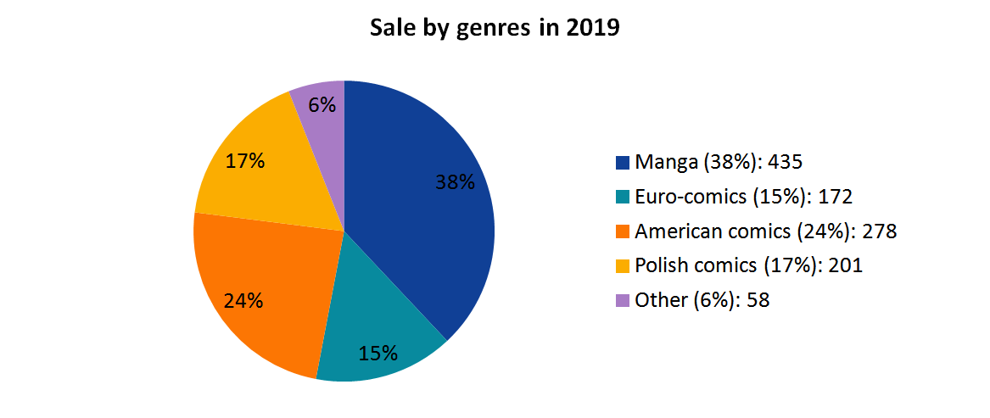
Polish comics market in numbers
Turnover: ~10 million €
Average price: ~9€

Slide 51
Polish comics market in numbers
2019 – 1144 titles published
2020 – 1032 titles published
It’s 10 times more than 20 years ago, and 3 times more than 10 years ago.
In recent years, more comics have been published in Poland each year than in the entire communist period combined.

Slide 52
Polish comics market in numbers
More than 40 publishers.
One big corporate entity – Egmont that has 25-30% of the market.
Two manga publishers who each has 13-15% of the market.
Ten more publishers who each has 2-3% of the market.
Publishers specialized in comic book types – european comics, american comics, manga, polish comics, graphic novels.

Slide 53
Digital comics in Poland
Fledgling market.
Some suspended experiments in the past years.
Manga publishers developing their own platforms – Studio JG (more than 100 titles), Waneko (40-50 titles), JPF (2).
One publisher participating in the European platform with polish comics in English – timof comics in Europe Comics.

Slide 54
Agenda
11h00 -11h05 Introduction of session – Thierry Baujard - Izneo
11h05 – 11h20 Creative Europe – Opportunities for the Book Sector- Arnaud Pasquali – European Commission
11h20 – 11h30 Project vision, objectives and activities – Thierry Baujard – Izneo
11h30 – 11h45 Why a project on distribution of E-comics – General trends – Luc Bourcier – Izneo
11h45 – 11h55 Preliminary results from quantitative and qualitative questionnaires- Opportunities and challenges – Enrico Turrin – FEP
11h55 – 12h00 – Italian market – Details – Piero Attanasio - AIE - Italy
12h00- 12h05 – Polish Market – Details - Paweł Timofiejuk – PSK - Poland
12h05 – 12h10 – Spanish Market – Details - Miguel Jiménez - FGEE - Spain
12h10 – 12h15 – Other countries – Details - Enrico Turrin – FEP - Belgium
12h15 – 12h30 – Questions and Comments from Clement Carasco – Creative Europe EU - Moderated by Thierry Baujard Izneo

Slide 55
FGEE
Spanish Association of Publishers
A federation of 9 associations, mainly regional
745 companies with more tan 1,000 imprints
Annual professional bookfair LIBER (Madrid/Barcelona)
Promoting attendance at trade fairs
ISBN agency and Dilve (Spanish books in print)
Lobbying, etc.

Slide 56
Spanish book market 2019
Total new titles:
  Paper 60,737
  Electronic 21,607
New comic titles:
  Paper 3,243
  Electronic 289
Turnover (domestic market; VAT included):
  Global 2,421 million €
  Comic 63 million €

Slide 57
Comic: big publishers 2019 (titles)
Planeta Cómic 648
ECC Ediciones 621
Norma Editorial 360
Editorial Ivrea 311
Panini España 304

Slide 58
Comic by genres 2019 (titles)
Graphic novel & Comic book: types
  European tradition graphic novels 29
  European tradition comic books, Bandes dessinées 661
  American / British style comic books & graphic novels 313
  Manga & Asian style comics 888
Graphic novels, Comic books, Cartoons 1.641

Slide 59
Comic 2019 by genres

Slide 60
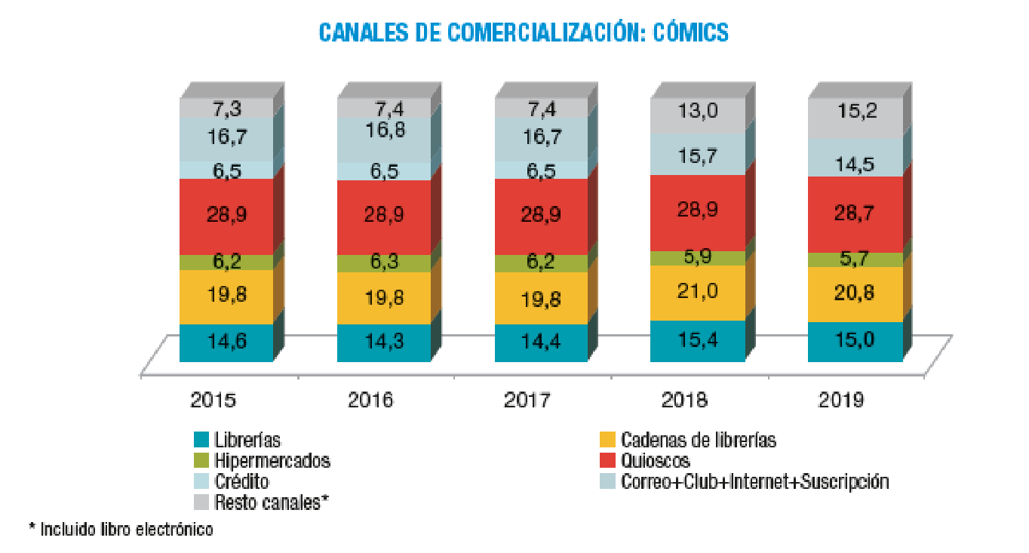
Comic market channels
Other (incl. e-book)
Post & suscription
Kiosks
Hypermarkets
Bookstore chains
Bookshops

Slide 61
Agenda
11h00 -11h05 Introduction of session – Thierry Baujard - Izneo
11h05 – 11h20 Creative Europe – Opportunities for the Book Sector- Arnaud Pasquali – European Commission
11h20 – 11h30 Project vision, objectives and activities – Thierry Baujard – Izneo
11h30 – 11h45 Why a project on distribution of E-comics – General trends – Luc Bourcier – Izneo
11h45 – 11h55 Preliminary results from quantitative and qualitative questionnaires- Opportunities and challenges – Enrico Turrin – FEP
11h55 – 12h00 – Italian market – Details – Piero Attanasio - AIE - Italy
12h00- 12h05 – Polish Market – Details - Paweł Timofiejuk – PSK - Poland
12h05 – 12h10 – Spanish Market – Details - Miguel Jiménez - FGEE - Spain
12h10 – 12h15 – Other countries – Details - Enrico Turrin – FEP - Belgium
12h15 – 12h30 – Questions and Comments from Clement Carasco – Creative Europe EU - Moderated by Thierry Baujard Izneo

Slide 62
Belgium (FR)
Publishers: 28
  Main ones: Dargaud-Lombard, Dupuis, Casterman
New titles: ?
Turnover: 86.6 M € (about 1/3 of total)
Average sales: 3,260
Average price: 15.02 €
Digital catalogue: ?

Slide 63
Belgium (NL)
Publishers: 47
  Main ones: Daedalus, Dupuis, Standaard
New titles: about 600
Turnover: 11.5 M €
Average sales: ?
Average price: 7.48 €
Digital catalogue: 4,000

Slide 64
Germany
Publishers: 125
  Main ones: Tokyopop, Panini, Egmont Manga, Carlsen
New titles: 3096
Turnover: 100-150 M €
Average sales: ?
Average price: 12.98 €
Digital catalogue: 6,132

Slide 65
Other countries
Austria: basically no comic publishers
Czech Republic: small market, main publisher (Crew) some 250 titles per year; online database (comicsdb.cz)
Estonia: very small market, hardly any comic books
Finland: comic books represent 1-2% of the market; 9 publishers, 150-200 new titles per year, mainly imported (Disney, manga, etc.); main publisher offers some digital content
Greece: no market to speak of, there used to be more
Ireland: small market, mainly US comics
Latvia: not much of a market, interest starting

Slide 66
Other countries
Lithuania: small market, hardly any comic books except graphic novels, imported and some local
Norway: small market
Portugal: comics represent 4-5% of the market
Romania: very small market
Slovakia: no relevant publishers, sales in Czech or English
Sweden: small market, main publisher is Danish
The Netherlands: small market, mainly imports from Flanders

Slide 67
Agenda
11h00 -11h05 Introduction of session – Thierry Baujard - Izneo
11h05 – 11h20 Creative Europe – Opportunities for the Book Sector- Arnaud Pasquali – European Commission
11h20 – 11h30 Project vision, objectives and activities – Thierry Baujard – Izneo
11h30 – 11h45 Why a project on distribution of E-comics – General trends – Luc Bourcier – Izneo
11h45 – 11h55 Preliminary results from quantitative and qualitative questionnaires- Opportunities and challenges – Enrico Turrin – FEP
11h55 – 12h00 – Italian market – Details – Piero Attanasio - AIE - Italy
12h00- 12h05 – Polish Market – Details - Paweł Timofiejuk – PSK - Poland
12h05 – 12h10 – Spanish Market – Details - Miguel Jiménez - FGEE - Spain
12h10 – 12h15 – Other countries – Details - Enrico Turrin – FEP - Belgium
12h15 – 12h30 – Questions and Comments from Clement Carasco – Creative Europe EU - Moderated by Thierry Baujard Izneo

Slide 68

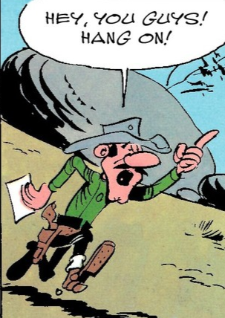
Questions / Comments

Slide 69
Thank you
www.eudicom.eu
t.baujard@izneo.com

