Slide 1
The Eudicom survey: opportunities and challenges
Preliminary results from the quantitative and qualitative surveys
Enrico TURRIN, Federation of European Publishers (FEP)
16 March 2022

Slide 2
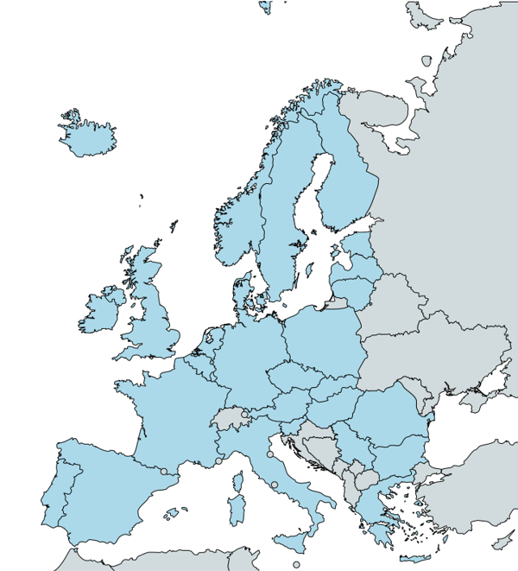
About FEP
FEP is an independent, non-commercial umbrella association of national book publishers' associations
FEP represents 29 national associations of publishers of books, learned journals and educational materials from 28 countries all over Europe, especially from the EU and of the EEA
Founded in 1967, FEP deals with European legislation and advises publishers associations on legislative and policy issues

Slide 3
The reseach
Objective
  Collecting information on the comic book market in Europe
  Assessing the degree of digitisation of the European comic book market
  Gathering input for the development of training tools
Methodology
  Quantitative questionnaire (partners in focus countries FR, IT, PL, ES + all FEP members)
  Qualitative questionnaire (interviews with publishers and stakeholders)

Slide 4
Main results - general
Overview of responses
  Detailed information from focus countries: France, Italy, Poland, Spain
  Comprehensive information from other major markets: Belgium, Germany
  A little information from about 20 more countries
Initial findings
  The comic book market is only significant in a limited number of territories
  Detailed information on comic book sales, especially in digital, is hard to come by
  Comics publishing is somewhat of a niche sector, often with realtively tenuous links with the rest of the sector (also in association terms)
  In most cases, the digital penetration in the sector is very low

Slide 5
Main results - quantitative
Data on main markets surveyed
  Production: big markets (FR, DE, IT, ES) produce 3-4,000 new titles per year (France on top), mid-sized ones (BE, PL) 1-2,000 (Belgium punches above its weight)
    European comics and manga the main genres
  Publishers: 100 to 400 in DE, IT, FR (FR has the most), <50 in ES, PL, 75 in BE (high given overall size)
  Turnover: comics represent 2 to 6% of the market in most territories, with notable exceptions France (10-15%) and French-speaking Belgium (around 33%)
  Average prices: between 7.50 and 15 EUR, with no clear link with a country’s income
  Digital catalogues: a few to several thousand titles in IT, ES, DE and more than 20,000 in FR; very few in PL

Slide 6
Main results - quantitative
Data on other markets
  Production: very little information available; likely in the hundreds of titles per year
  Publishers: often very few, sometimes barely any
  Turnover: very small share of total market, in most cases <2% (there are exceptions)
  Market overview: niche market, mostly based on imported titles
  Level of digitisation: very low

Slide 7
Main results - qualitative
Digital presence and strategy
  Digital presence and marketing but little if any digital products and sales
Plans to go digital
  There is an intention, provided the conditions are ripe
Attitude towards digital
  Positive but cautious; purely digital option not seen as viable
Challenges and opportunities of going digital
  Readers’ attachment to paper (collectors), piracy, business models, risk of wrong placement of product (digital media); still a potential opportunity
Possible use for a dedicated platform
  Yes! Accessible, fair, effective, technologically supportive

Slide 8
Initial remarks
Data collection
  There are difficulties in finding data and in comparing different countries
  We plan to continue or effort throughout the project
  We welcome input from all interested stakeholders
The market
  The digital market for comics is very small
  There is a huge opportunity for growth if the demand is there, a largely untapped potential
  There is potential for our platform to provide support in tapping this potential
  There is a risk that non-European players fill that void

Slide 9
Italy
Publishers: 265
  Main ones: RW Edizioni, Edizioni BD, Star Comics, Panini Comics
New titles: 2,904 (2019), 603 digital (2020)
  Main genre: manga
Turnover: 43 M € (bookstores only)
Average price: 14.07 €
Digital catalogue: 3,776 (2020)

Slide 10
Poland
Publishers: 40+
  Main ones: Egmont Poland, Waneko, Studio JG
New titles: 1,032 (2020)
Turnover: 10 M €
  Main genre: manga
Average price: 9 €
Digital catalogue: a few hundred

Slide 11
Spain
Publishers: 40-50
  Main ones: Planeta Cómic, ECC Ediciones, Norma Editorial, Editorial Ivrea, Panini España
New titles: 3,243 (289 digital)
Turnover: 63 M €
Average price: 7.67 €
Digital catalogue: 5,387 (2020)

Slide 12
Belgium (FR)
Publishers: 28
  Main ones: Dargaud-Lombard, Dupuis, Casterman
Turnover: 86.6 M € (about 1/3 of total)
Average sales: 3,260
Average price: 15.02 €
GfK study 2021: 5.5 million volumes sold (+45% vs 2020), comics have become the top sales category

Slide 13
Belgium (NL)
Publishers: 47
  Main ones: Daedalus, Dupuis, Standaard
New titles: about 600
Turnover: 11.5 M €
Average price: 7.48 €

Slide 14
Germany
Publishers: 125
  Main ones: Tokyopop, Panini, Egmont Manga
New titles: 3096
Turnover: 100-150 M €
Average price: 12.98 €
Digital catalogue: 6,132

Slide 15
Other countries
Austria: basically no comic publishers
Czech Republic: small market, main publisher (Crew) some 250 titles per year; online database (comicsdb.cz)
Estonia: very small market, hardly any comic books
Finland: comic books represent 1-2% of the market; 9 publishers, 150-200 new titles per year, mainly imported (Disney, manga, etc.); main publisher offers some digital content
Greece: no market to speak of, there used to be more
Ireland: small market, mainly US comics
Latvia: not much of a market, interest starting

Slide 16
Other countries
Lithuania: small market, hardly any comic books except graphic novels, imported and some local
Norway: small market
Portugal: comics represent 4-5% of the market
Romania: very small market
Slovakia: no relevant publishers, sales in Czech or English
Sweden: small market, main publisher is Danish
The Netherlands: small market, mainly imports from Flanders

Slide 17
Recent developments - global
“From São Paulo to Seville and from Paris to Palermo: the comics boom is unstoppable and is responsible for a not inconsiderable proportion of rising overall market sales”
In the nine countries surveyed (BE, BR, FR, DE, IT, NL, PT, ES, CH), “sales of comics increased by almost half, reaching peaks in Italy (+98.0 percent) and Portugal (+72.7 percent)”
“Even more impressive was the performance of mangas and manhwas, sales of which rose by over 100 percent in many places” (GfK Entertainment special analysis 2021)

Slide 18
Recent developments - webtoon
Wattpad was acquired by Naver, the South Korean conglomerate which also owns WEBTOON (on which it publishes webtoons), in May 2021
Naver spent 100 million USD on the merger of the studio departments of WEBTOON and Wattpad (announced in June 2021); combined audience: 166 million people
WEBTOON has also partnered with DC Comics to create webtoons with DC characters

Slide 19
Recent developments - webtoon
Wattpad was acquired by Naver, the South Korean conglomerate which also owns WEBTOON (on which it publishes webtoons), in May 2021
Naver spent 100 million USD on the merger of the studio departments of WEBTOON and Wattpad (announced in June 2021); combined audience: 166 million people
WEBTOON has also partnered with DC Comics to create webtoons with DC characters
Korean platforms are gradually taking over the European market; Korean and Japanese consider the French market easier to penetrate because of its comics tradition

Slide 20
Recent developments - France
Webtoons remain on the rise
Streaming services tend to boost comics sales, particularly manga: when anime series are released on Netflix, manga sales increase visibly
Manga readership is now generations-old: from Dragon Ball readers, to Naruto, to newest releases with younger audiences
The extension of the Culture Pass coincided with an increase of manga sales; however, manga were already going strong, with double-digit sales for more than 5 years in a row
While some booksellers report up to 1/3 of manga sales as due to the culture pass, analysts say the Culture Pass explained 6% of additional sales in 2021 (total sales were 47 million vs 22.5 million in 2020)
According to a survey conducted in June 2021, 84% of the Culture Pass was spent on books, and 71% of these books were manga

Slide 21
Recent developments - France
Latest data on 2021 from GfK study from January 2022 (check out their presentation at the festival)
Total turnover comics: 889 M EUR, 85.1 M titles sold; +50% revenues, +60% volume vs 2020
BD is the second largest category of book sales (24%) after general literature
1 comic book sold out of 2 is a manga; manga sales grew 107% in 2021
In the top 10 sales of comic books, 7 titles are manga
1 book buyer out of 3 is a comic book buyer (7.2 M people aged 10+)

Slide 22
Recent developments - Italy
Recent research (December 2021) by Italian Publishers Association, in collaboration with Aldus Up and EUDICOM and Lucca Comics&Games on comics readers
Comics readers between 8.27 M (IPSOS, age 15+) and 8.7 M (AIE, age 14+)
Comics readers are 18% of the population (21% of men, 14% of women)
Main incidence of comics reading at ages 18-54 (20% or more)
They are strong readers: 17.5 comic book volumes per year
Print readers read 15.2 print comics on average, digital readers read 9.7 digital comics on average

Slide 23
Recent developments - Italy
Research by the Italian Publishers Association on the Italian book market in 2021
Massive increase of comic book sales: from 4.7 to 11 million copies sold (2020 to 2021, +134%)
Comic books rose from 4th to top category in book sales

Slide 24

THANK YOU!
Enrico TURRIN
Federation of European Publishers
eturrin@fep-fee.eu

